Slide 1

Agile 2-DB Systel
Neeraj Vohra

Slide 2

Glossary
Theme
Epic
Feature
User Story
Tasks
DEEP
DIVE
SMART
INVEST
Timebox
Sprint
Scrum
Spike
Definition Of Ready
Definition Of Done
Velocity
Spike
Technical Debt
Impediments
Parking Lot
Poker Planning

Slide 3
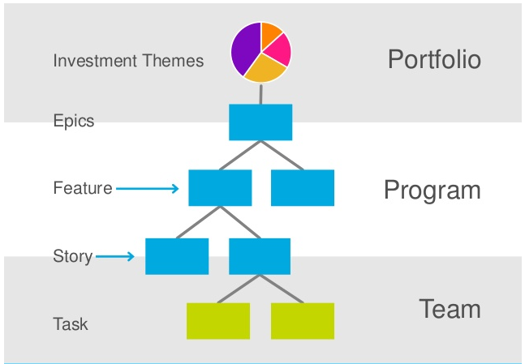
Theme,Epic,Feature,User Story and Tasks

Slide 4
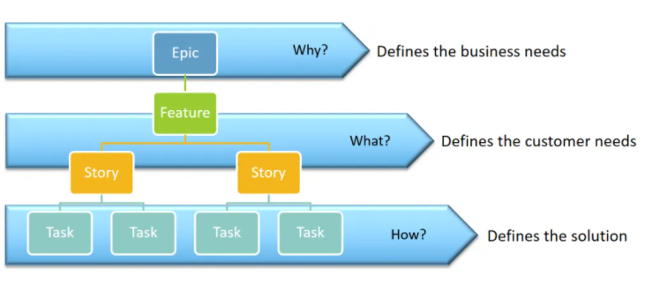
Theme,Epic,Feature,User Story and Tasks

Slide 5
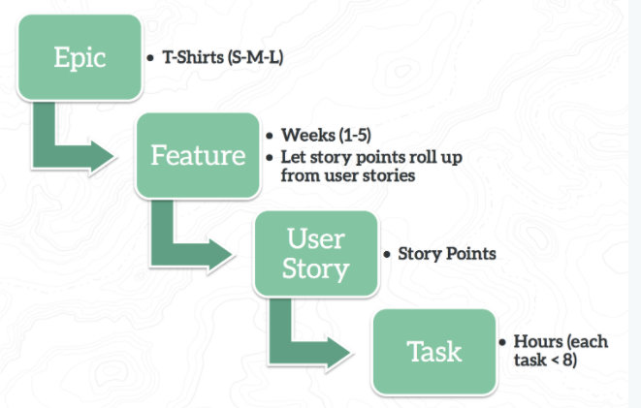
Theme,Epic,Feature,User Story and Tasks

Slide 6
Epics and Feature
Breaks the vision down into
Epics: High level outcomes needed to accomplish the vision
Features: Specific changes needed to deliver the Epics.
This can be estimated at a high level ( T-shirt size) to determine the product road-map.
Typically, 1-3 months duration.
Epic can span more than one team.
Epic spans releases.

Slide 7
Features
Smaller than epics, typically 2-4 weeks in duration.
Features are contained with in release.
Ideally features are contained within a team.
These are what the product owner cares about.
Provides value to the user.
Realized by some number of user stories.

Slide 8
User Story
User Stories are the smallest increment of value, typically less than a week .
User Stories are contained with in the sprint.

Slide 9
Tasks
A Task is simply a task. In agile, it would typically be something like code this, design that, create test data, validate test assumptions etc
Tasks are usually done by one person in the team and completed within a day. Tasks are about implementation; User Stories are about definition.
How do you write a good task? Keep it simple.
Think Keep It Simple Silly (KISS).

Slide 10
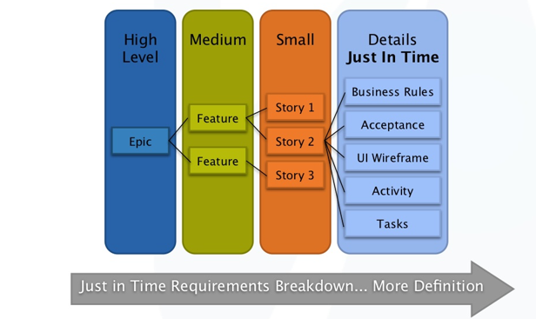
Elaboration /Decomposition

Slide 11
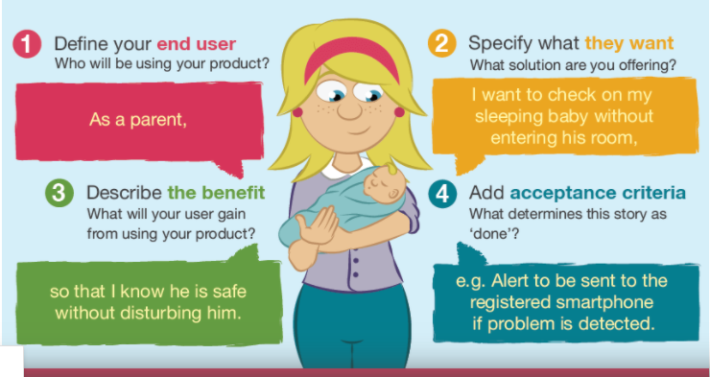
How to write User Stories
Notes:
Who is this story for
What they want to do
Why they want to do

Slide 12
How to write User Stories
As a ( person or user):
Who is this person we are building a feature for?
How does this person think?
How do they work.
I want ( some goal):
What is the user intent?
What is he/she trying to achieve?
How to help the user intent?
… So that (benefit , purpose, reason):
How does the user’s desire to achieve something fit into a bigger picture?
Know will we deliver the value to the user?
Will our solution solve user’s problem?
Notes:
Role
Goal
Benefit

Slide 13
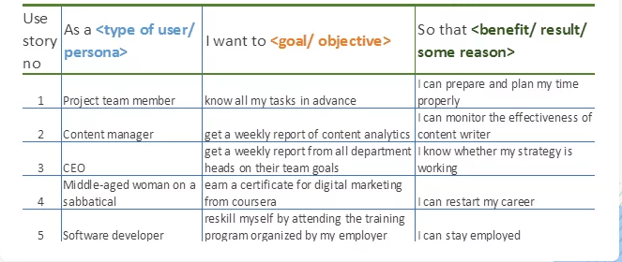
How to write User Stories

Slide 14
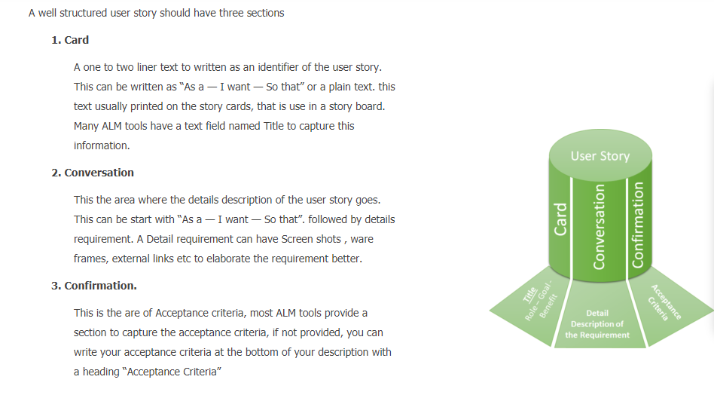
Understanding the 3Cs

Slide 15

Glossary
DEEP-DIVE into Product Backlog
INVEST in Stories
Create SMART Plan/Tasks

Slide 16
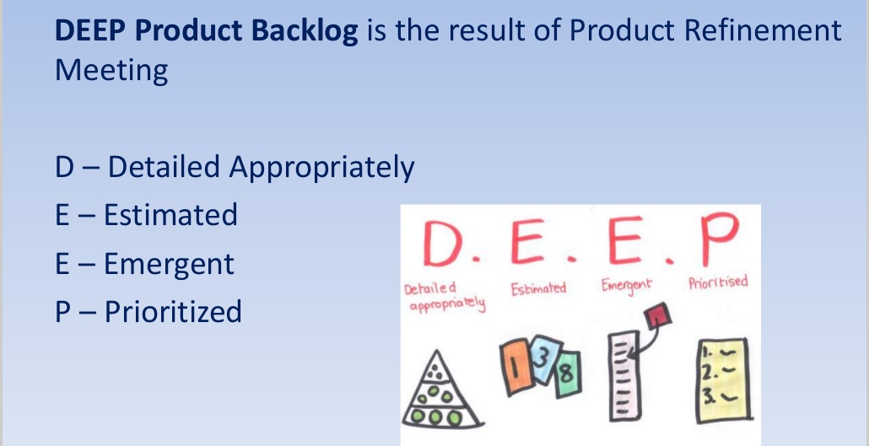
DEEP- Criteria
.

Slide 17
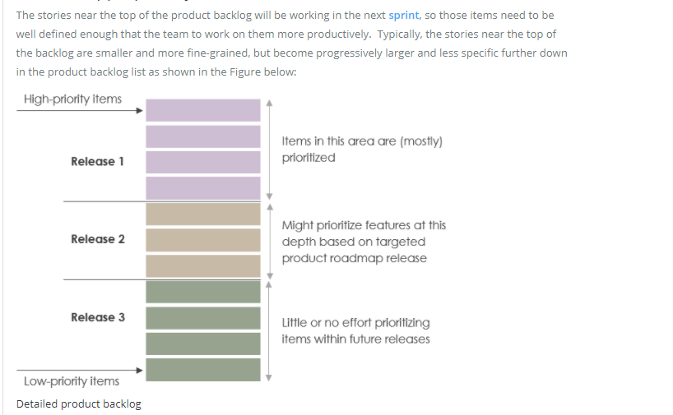
Detailed Appropriately

Slide 18
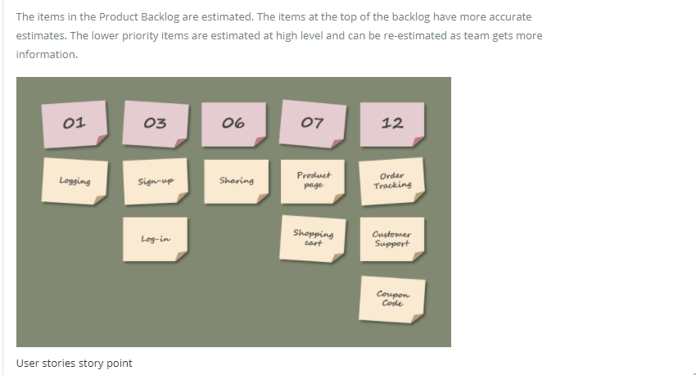
Estimated

Slide 19
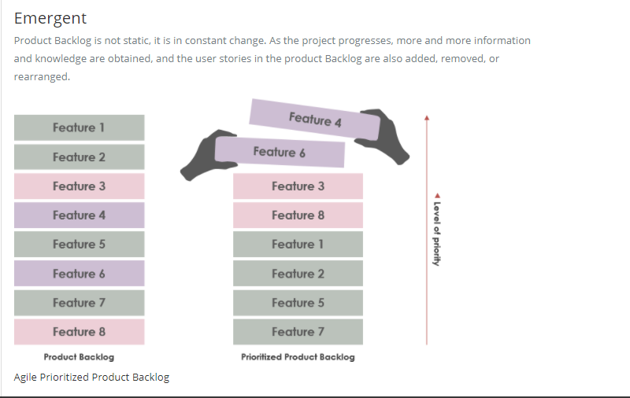
Emergent

Slide 20
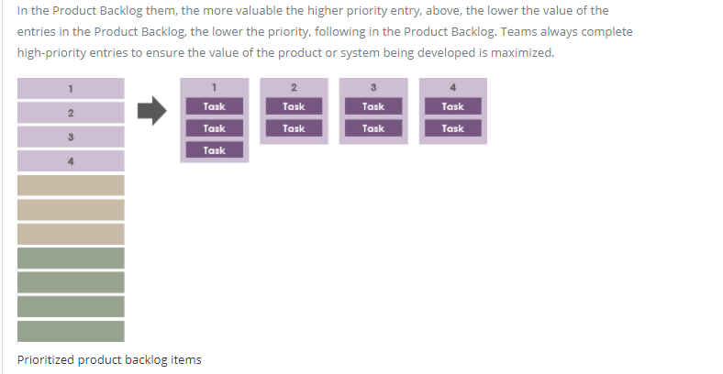
Prioritized

Slide 21
Dive Criteria
Product backlog work Items are linearly ordered based on the DIVE Criteria.
Dependencies:
Usually the Backlog items are independent there may still be few unavoidable dependencies and they will have an impact on rank ordering. We need to order backlog items according to their dependencies if any item X is dependent of item Y, Y need to be Ranked higher then X.
Insure against Risks: Business and Technical:
Backlog items should be Insured against business, Infrastructure, technological and Resource risks.
Business Value:
Backlog items with higher business value should be ranked higher.
Estimated Efforts:
Backlog items should be estimated, and effort should be attached with them. Effort can be marked as Story Points. These story points will help us in gauging whether that story can be pulled in current sprint backlog or not.

Slide 22
SMART- Criteria
If your goal (and the plan) fulfill the SMART criteria, there is a much better chance you will execute the plan and reach the goal. Defining the first step helps building momentum especially in team.
Specific:
State exactly what you want to achieve.
Clear to everyone
Who will do? Do it how when?
Measurable:
What will we measure to see if we are moving into right direction? How will we know that we have achieved the goal?
Achievable:
Is this realistic plan and goal?
How much influence do you have on the outcome.
Weigh the effort, time and other costs against the profits, obligations and priorities.

Slide 23
SMART- Criteria
Relevant:
We’ve all got limited time and energy. Is this even important? Why are we doing it?
Decide If your team has the bandwidth, skills, training, resources and plan.
Timely:
When will it be done? When will we check progress? Prefer closer dates so that you have a short feedback loop.

Slide 24


INVEST- Criteria
A well-formed user story needs to meet the INVEST criteria.
Independent:
The user story should be self-contained, in a way that there is no inherent dependency on another user story.
Stories Ideally describe non-overlapping bits of functionality, possible to implement in any order, we can develop in any sequence.
There should be no dependencies between stories.
Negotiable:
User Stories are not explicit contract and should leave space for discussion.
User stories can always be changed or rewritten up until the point of coding.
Avoid to much details keep them flexible so the team can adjust how much of the story to implement.

Slide 25


INVEST- Criteria
Valuable:
A user story must deliver value to the stakeholders or business.
Stories value makes sense from a customer or end user’s perspective . They are not described in terms of a developer’s tasks.
Estimatable:
The team can estimate the difficulty of the story( at least to a rough level).
The Team must be able to use them for planning purpose.
A story must be understood well enough to be estimated.

Slide 26

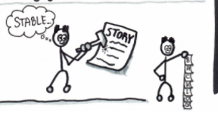
INVEST- Criteria
Small:
User stories should not be too big or too small in the context of the deadline.
The Story should be able to be designed, coded and tested with in the sprint.
They should be small , one sprint or less.
Testable:
Document acceptance criteria, or the definition of done for the story, which leads to test cases.

Slide 27
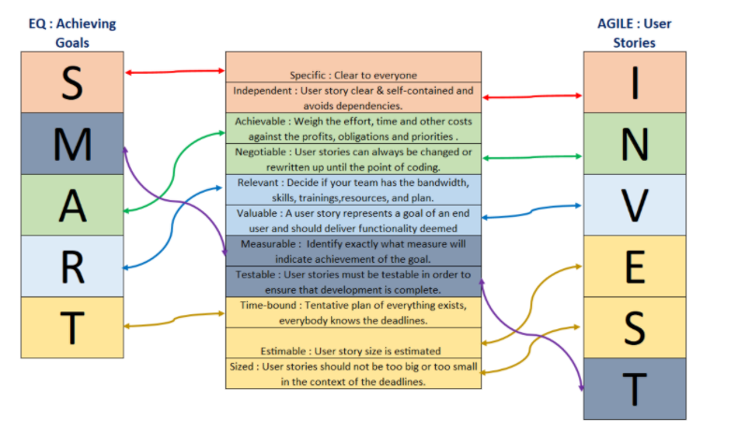
SMART- INVEST

Slide 28
Timebox
Under the Scrum Framework, all activities are time boxed, also known as “timeboxing” or timeboxed, is to give a “fixed length” time segment to a specific event or activity. That unit of time is called a time box. The goal of timeboxing is to define and limit the amount of time dedicated to an activity. Scrum uses timeboxing for all the Scrum events and as a tool for defining open-ended or ambiguous tasks.
The Following is a “time box” of the 5 events corresponding to a 1-week Sprint in Scrum
Sprint Planning: The timebox should not exceed 2 hours / Sprint length is 1 week.
Daily Scrum: The timebox should not exceed 15 minutes.
Sprint Review: The timebox should not exceed 1 hour / Sprint length for 1 week.
Sprint Retrospective: The timebox should not exceed 1 hour / Sprint length for 1 week.

Slide 29
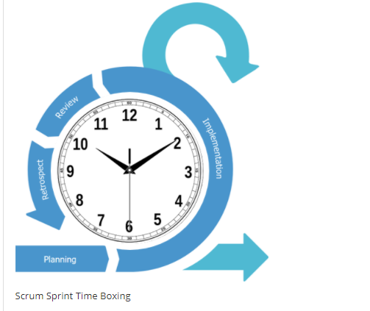
Scrum Sprint Time Boxing

Slide 30
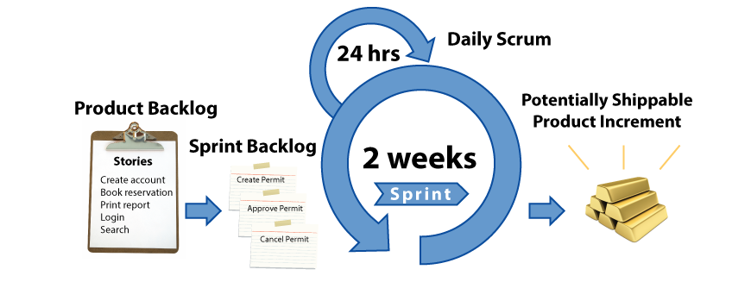
Scrum/Sprint
The most popular of Agile methods today, Scrum is an project management framework that encourages teams to self organize and deliver functionality iteratively in two-week time boxes called sprints.

Slide 31
Sprint 0
Sprint Zero is the iteration that is used to get prepared for the project execution.
Everyone does not support sprint Zero. That’s because it does not produce any output, which is shippable. Sprints always target a shippable output.
Sprint Zero is used for the following reasons. This is just an indicative list.
Acquiring servers or hardware resources for the project
Assembling the team
Developing the initial backlog items (A few stories)
Application Architecture design

Slide 32
Spike
A task aimed at answering a question or gathering information, rather than at producing shippable product.
It is not uncommon to create proof of concept (POC) or feasibility study or even research to estimate a user story correctly. A spike is created to conduct the task so that we can do the estimation correctly.
Spikes can be of three types:
Functional: Analyses a story by decomposing it and identifying risks
Technical: determines the feasibility or impact of a story or task to understand the technical design necessary.
Exploratory: explores organizational risks or impacts for a particular story.

Slide 33
Technical Debt
The Technical Debt concept is an effective way to communicate about the need for refactoring and improvement tasks related to the source code and its architecture.
What incurs Technical Debt?
Code that is not quite right may include many types of issues. These issues may be related to architecture, structure, duplication, test coverage, comments and documentation, potential bugs, complexity, code smells, coding practices and style. All these types of issues incur technical debt because they have a negative impact on productivity

Slide 34
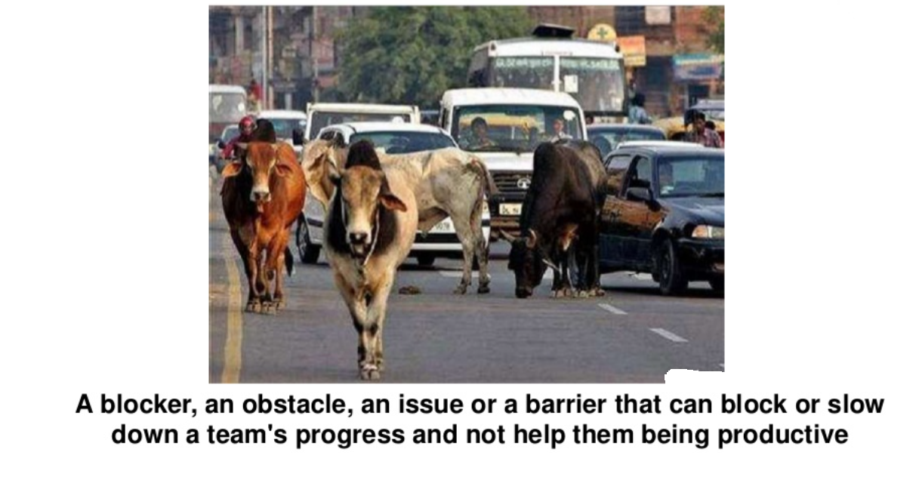
Impediments- Silent killer of agile teams

Slide 35
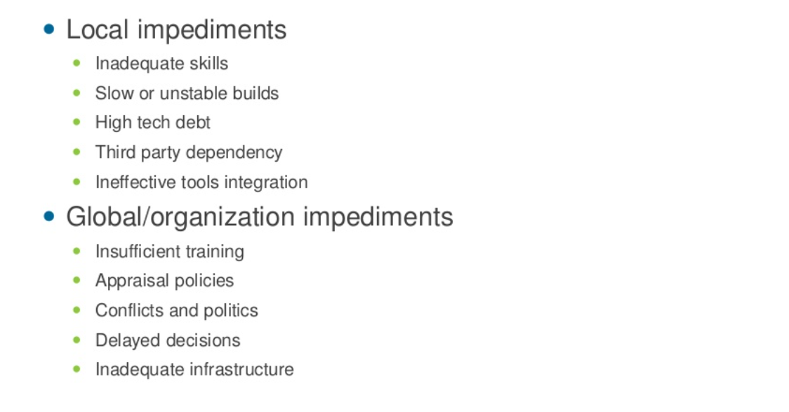
Types/Example of impediments

Slide 36
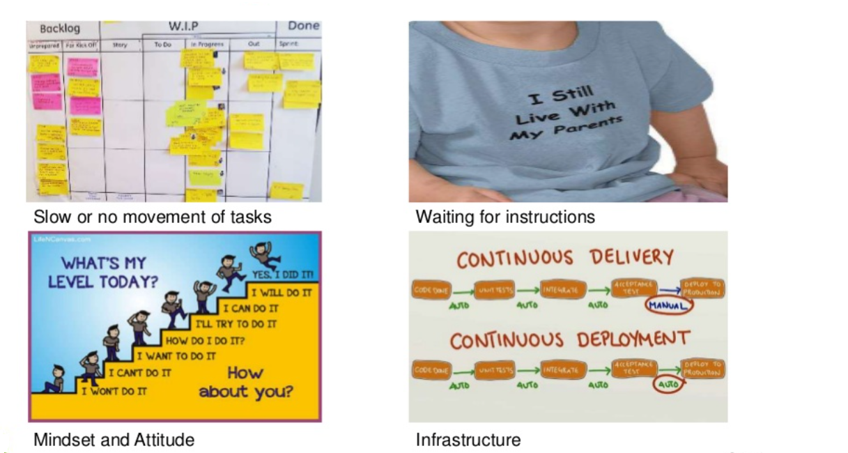
Where are impediments hidden?

Slide 37
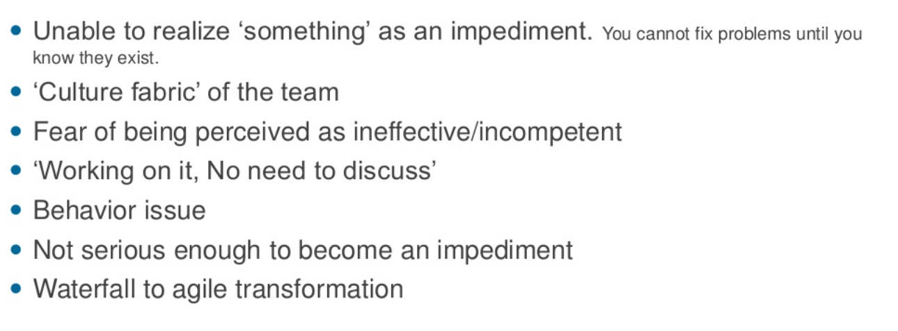
Difficulty in raising impediments

Slide 38
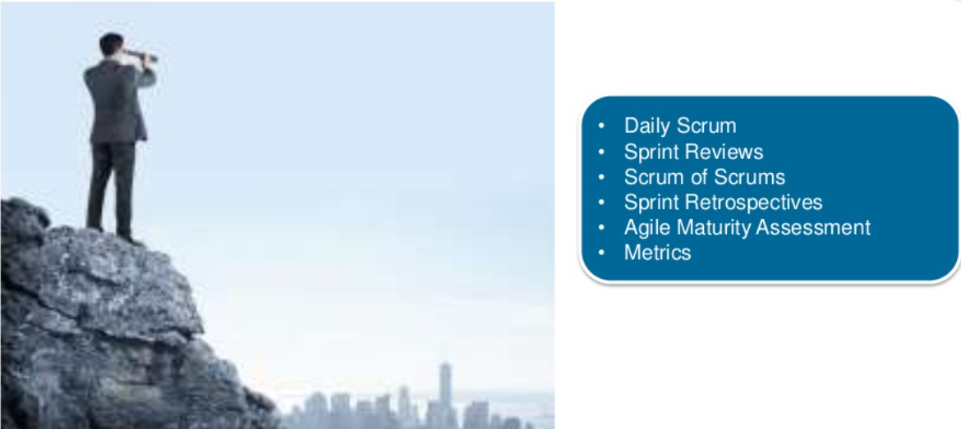
Hunting ground

Slide 39
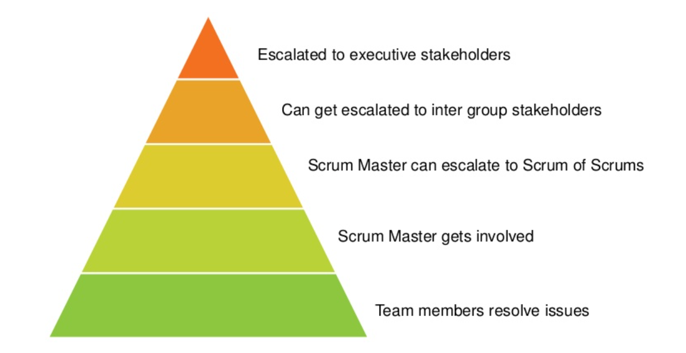
Levels of impediments management

Slide 40
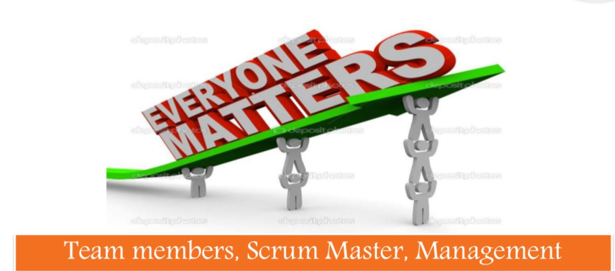
Whose responsibility It is?

Slide 41
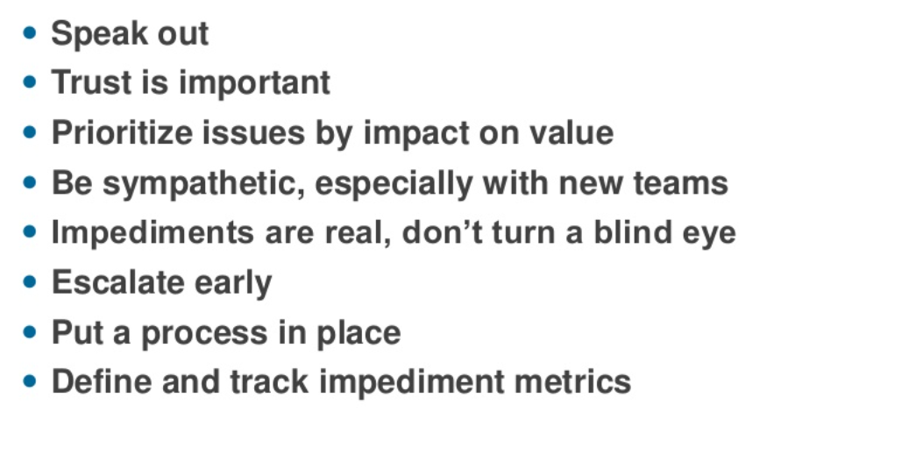
Lesson learned

Slide 42
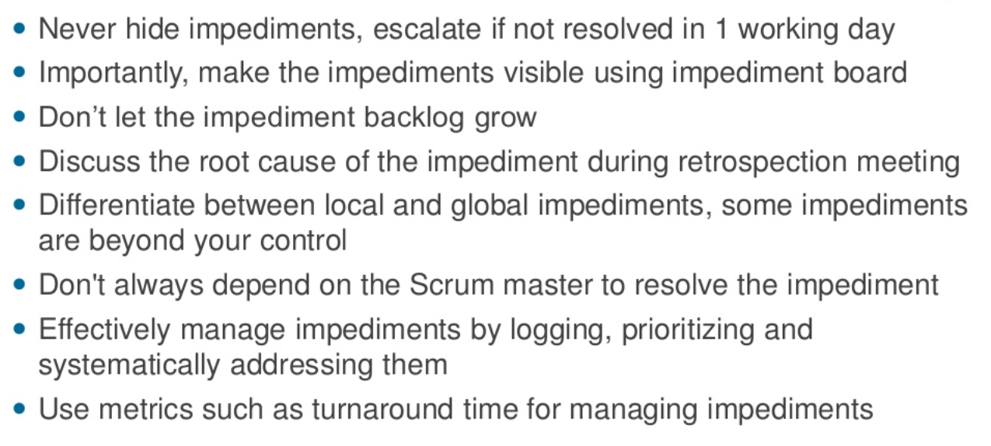
Few tips

Slide 43
PARKING LOTS- What did we don’t discuss
On the whiteboard / paper, draw a square box and label it ‘Car Park’. This will become a space where you can ‘park’ ideas, suggestions, questions or feedback that are not directly associated with the topic.
The scrum master (or even a team member, meeting facilitator) has the right to say, “This is off topic, lets car park this and take it off-line”.
You then write the topic on a post it note and stick it in the car park for later discussion.
At the end of the daily stand up / agile meeting, you can then quickly review the board; you might find that some questions have already been answered, and topics that involve certain people can then commence.
The Parking Lot helps to track important items, ideas and issues that may not be useful to discuss at a time in the agenda.
The parking lot essentially becomes an extension of the daily scrum.
The parking lot helps to track important items, ideas and issues that may not be useful to discuss at time in agenda. The principle is to return to them later. (Let review it at the end of the day 10-15 min).

Slide 44
Thank You

